Slide 1
Accident/Incident Training
Investigation and form filling out
For foremen and higher level

Slide 2
What should be Investigated?
All job-related accidents (injury and/or property damage)
All job-related incidents (could have caused injury and/or property damage) involving:
  Employees
  Clients/visitors
  Property
Notes:
Accidents-an unplanned event(s) that caused personal injury and/or property damage
Incidents- an unplanned event(s) that could have caused personal injury and/or property damage.
All accidents with or without injury, incidents, and any property damage situations must be investigated no matter who they involve whether employee, visitors, or clients. If you are unsure if something should be investigated or not, it’s best to be on the safe side and investigate it.
Examples would include but not limited to
Backing into something
Personal injury
Visitor trips and falls, yes complete
Make sure you never say to anyone that the “state will take care of it” or “the state will pay for it.” Saying anything like that puts the agency/state in a liable condition.

Slide 3
Purpose of Investigation
Determine the cause.
Implement corrective action to prevent future occurrence.
Document facts/findings at the scene.
Notes:
When determining the cause, you want to find out the facts….you are NOT trying to find fault or place blame.
The primary cause for investigating an accident is to PREVENT re-occurrence of a similar incident/accident. You want to make sure corrective action is appropriate and effective (document if the situation merits). Some ask why investigate an incident and the answer is simple. If something happened and no on was injured and/or property was not damaged, how can we prevent it from happening again (and maybe this time with serious injuries) if we do not know about it and/or do not know what caused it. Preventing further incidents/accidents helps to reduce the agency’s costs.

Slide 4

Steps of an Investigation
Notes:
Definition:
Investigation: [n] the work of inquiring into something thoroughly and systematically
REMEMBER YOU ARE FACT FINDING, NOT FAULT FINDING!!!
Secure the Scene
Gather information, data, measurements, photos, statements, etc.
Identify unsafe act/condition/contributory factors
Determine preventive measures and tools for short & long term

Slide 5
Gathering Information
WHO?
WHAT?
WHEN
WHERE?
WHY?
HOW?
Notes:
When asking the questions again remember are on a fact finding mission.
We want to find the primary/root cause of the incident/accident to prevent it from happening again.
You want as specific an answer as possible for each question that is applicable.

Slide 6
Gathering Information
View accident scene promptly (Conditions can change)
Provide a clear description of the incident/accident
Provide a clear description of the location
Take photographs
  Attach copies to accident report
  Keep originals on file
Notes:
1. Go to the scene as soon as possible. Conditions change as mentioned before. Example is lighting might change due to time of day. Might even need to go back at the same time of day the next day to see if there was anything with that time of day lighting.
What were the conditions before, during, and after the accident?
2. Need to get a clear concise description of the incident/accident. Does “tripped and fell” tell me anything? What were you doing, carrying anything, someone blow a horn and scare you? Get the most complete description that you can.
3. Description should be concise enough that I could go back and find the location of the incident/accident again if needed. Does “parking lot” give me a good location? State landmark or measurements from landmarks so the area can be located.
Take photos of the incident/accident scene. Keep a log as you are taking them so you do not have to try and figure out what something is when you get back and print the pictures. Take photos from different directions and note the direction of the view taken.

Slide 7
Gathering Information
Collect any pertinent items associated with incident/accident
  Label and secure necessary items
Notes:
Any items related to the incident/accident should be preserved. Might be needed at a later date. The item should be labeled as to what it is, what incident/accident related too, (labeled do not throw away) and stored in a secure location. Make sure you note in incident/accident report that the item is stored. Examples could be a chair or bench that someone fell out of because it broke for some reason.
Measurements should be taken if relevant. Distances, heights, elevation changes, lengths of items, etc.

Slide 8
Gathering Information
  Identify witnesses
    Name, contact numbers, and home address
  Get written statement (signed and dated)
    Operator/person injured and of any witnesses
    What they actually saw or heard
  Conduct Interviews
    If needing any other information is needed
    Document any verbal information
    Clarify reported information
Notes:
Written statements should be the day of accident/incident within 24 hours
Interview tips:
Select an appropriate location preferably free of distractions/interruptions. Keep witnesses separate.
Take notes (try to record exact wording)
Explain the purpose of the investigation (reassure that you are not trying to place blame)
Make sure you do not prompt or lead the witness.
Be a good listener – do not interrupt witnesses.
Ask questions “Who, What, Where, and How “
Caution the witness not to guess
Encourage non-verbal communication such as drawings, gestures,
Give full attention to the witness
Assume nothing
Show courtesy and patience

Slide 9
Identify Preventive Measures & Tools: Root Cause Analysis
Unsafe act
  A behavioral departure from an accepted, normal, or correct procedure or practice--which has produced injury or property damage or has the potential for doing so; an unnecessary exposure to a hazard; conduct that reduces the degree of safety normally present in an activity.
Unsafe Condition
  Any physical state which deviates from that which is acceptable, normal, or correct as regards past or potential future production of injury/illness and property damage; any physical state which reduces the degree of safety.
Contributing Factors
  Inadequate policy/procedure
  Failure to enforce policy/procedure
  Failure to train involved employee
  Faulty equipment design
  Mental condition of employee involved
Notes:
In order to prevent future accidents we determine the root cause analysis which is composed of:
Unsafe Act
Unsafe Condition
Contributing factors
Why was the act committed
Why did condition exist
Immediate action take to prevent reoccurrence
Long range action to be taken
What additional assistance is needed to prevent recurrences
Unsafe Act
Very important to identify so can prevent re-occurrence.
Basically: It’s a behavior, action or non-action by an individual.
Examples of unsafe acts:
Not using protective equipment
Operating machinery and equipment without qualifications or authorization
Operating equipment at unsafe speeds
Bypass or removal of safety devices
Improper repair practices on equipment
Not following procedures
Under influence of drugs or alcohol
Working on machinery knowing it doesn’t have the appropriate guards
Using equipment that is not suitable for the task
Failing to warn others of danger
Not taking enough time to set up and use equipment/PPE properly.
Yanking electrical cords unplugged from a distance, which could damage electrical components.
Neglecting to clear the work area of excess rubble and clutter that may create trip hazards.
Pushing yourself too hard by lifting too much or doing too much work.
Unsafe condition
Physical location/equipment/surrounding factors
Examples of Unsafe Conditions:
wet or slippery floors
Defective or broken tools, equipment, or supplies
Inadequate supervision
poor housekeeping
poor ventilation
cluttered hallways, stairs, exits, and entrances
defective electric wiring, lighting or outlets
Inadequate guards on machinery and equipment
congestion of the work place
Fire and explosion hazards
failure to erect railings, nets and/or safety barriers
exposure to harmful chemicals or biological agents
improper storage or disposal of materials and tools
Inadequate or no warning signs
No policy or procedure in place
Contributing factors
Could also include nature/uncontrollable events such as: rain, snow, ice, mud on roadways, tornado, flooding, etc.
As you can see sometimes these items could overlap each other. When identifying the cause, you could have just an unsafe act or an unsafe condition or you could have both at the same time with or without contributing factors. But usually there is something that caused it. Even the bee sting! Investigate it. If you start the investigation and look around you might discover that there is a nest that no one knew about that is aggravated each time a certain door is opened and closed. Investigate, Look, Ask questions, but remember to find facts not fault.

Slide 10
Preventive Measures and Tools
  Job Safety Analysis
  Review/Revise/Devise policies, procedures, or rules
  Enforce policies, procedures, or rules
  Obtain additional training
  Provide training to employees
  Promote employee participation
  Ensure safe work conditions
  Ensure proper job placement of employees (re: physical limitations)
Notes:
These are areas/items that can be used to prevent incident/accidents. These are basically administrative.
1.JSAs-the development and proper use of with employees
2. Ensure policies, procedures, rules are develop to provide instruction and revise them as needed. Make sure policies/procedures include provisions for discipline if policies/procedures are not followed.
3. Enforce the policies, procedures, rules that are develop. If not enforced do not help protect the employees or the agency.
4. Obtain additional training when needed even if needed from an outside source.
5. Train your employees -new employees, on new equipment, new procedures, change in procedures, or when employees are observed not following correct procedures.
6. Encourage the employees do the right thing. Tell them why it is a good thing, praise them for doing the correct thing.
7. Ensure that the work conditions are safe, if not make sure you get corrected. If management does not show interest in doing its tasks in the correct manner do you think the employees will care.
8.As stated.

Slide 11
Preventive Measures and Tools
Workplace provisions:
  PURCHASE NEW TOOLS & EQUIPMENT
  REDESIGN THE WORK AREA
  IMPROVE HOUSEKEEPING
  INSTALL WARNING DEVICE
  ADD TO EXISTING SIGNAGE
  REMOVE BROKEN EQUIPMENT OR TOOLS
  IMPROVE LIGHTING AND VENTILATION
  LIMIT ACCESS
Notes:
These are basically physical items.
When tools worn out/broken replace them.
Redesign the work area to reduce hazards. Example is put a hazardous job in an out of the way location in shop to reduce the amount of traffic through the area while the task is performed.
Clutter always causes problems, tripping hazards for one, fire prevention, and an added benefit is you can find something when you look for it.
As stated
Ensure the proper signs are posted. Just don’t over do so employees are desensitized to posted notices.
Remove from service and throw away or lock up where cannot be gotten and used anyway.
Better lighting and ventilation
Limit the number and people that go through an area, especially hazardous areas.

Slide 12
Accident/Incident Steps
Report Accident/Incident as soon as possible
  Needs to be done by the end of day
Follow the Accident Check List
  Step by step process
Do not be scared to call
  Chris McMorris
    Cell-225-354-9908
    Work- 225-242-4675
Who conducts Investigation
Notes:
Report accident as soon as possible. Needs to be no later than 12 hours after accident/incident
Accident check list shows the step by step process of what to do with accident/incident.
Do not be scared to call for help. Whether it be not knowing how to fill something out, what steps to follow, or just to let me know what happen.
Foremen or higher levels should investigated the accident/incident. You should not investigated own accident/incident. It should be someone higher than you.

Slide 13
What to do when you get in and accident
Scene of the accident
  Call supervisor
    Supervisor will determine if you need to call police or not
      If police are called, get police report number
  Take pictures of both vehicles (email to supervisor)
  Get the other drivers information (private citizen information page)
  If you require medical attention fill out the Authorization for Medical Treatment form and give to attending physician.
Notes:
Need police report if wreck is involving any type of private citizen vehicle, equipment, or property.
If it is just our vehicles and/or property, up to supervisor if police report is needed.
More pictures the better. Vehicle, property, driver license, area where accident happen, insurance cards
All forms will be included with accident/incident check list. They can be found on the intranet also.
Must have private citizen information if private citizen was involved.
Operator or person that got injured written statement of what happen. Also any witnesses.
Send emails of pictures/forms as soon as possible, but no later than 24 hours.

Slide 14
5. Supervisor
Email pictures to Chris McMorris (chris.mcmorris@la.gov)
Email should include: Section number, employee name, accident date, and equipment number.

Slide 15
Forms to fill out ( All forms located under loss prevention on intranet)
(Please write clearly)
Motor Vehicle Forms
1- Supervisor sends paperwork and photos to Chris McMorris (safety)
a- Incident /Accident checklist/notification form
b- Accident report form DA2041
c-Private Citizen Information form
d-Witness statements and employee/driver statements
e-Supervisor Vehicle Equipment Investigation form
f- Police report if available

Slide 16
Personal Injury Forms
1- Supervisor sends paperwork to Chris McMorris (safety)
a- Authorization for medical treatment
-filled out by supervisor and attending physician
b- State employee Incident Accident Investigation Form DA 2000
c- Workers Compensation First report of injury and illness
d- Job Description

Slide 17
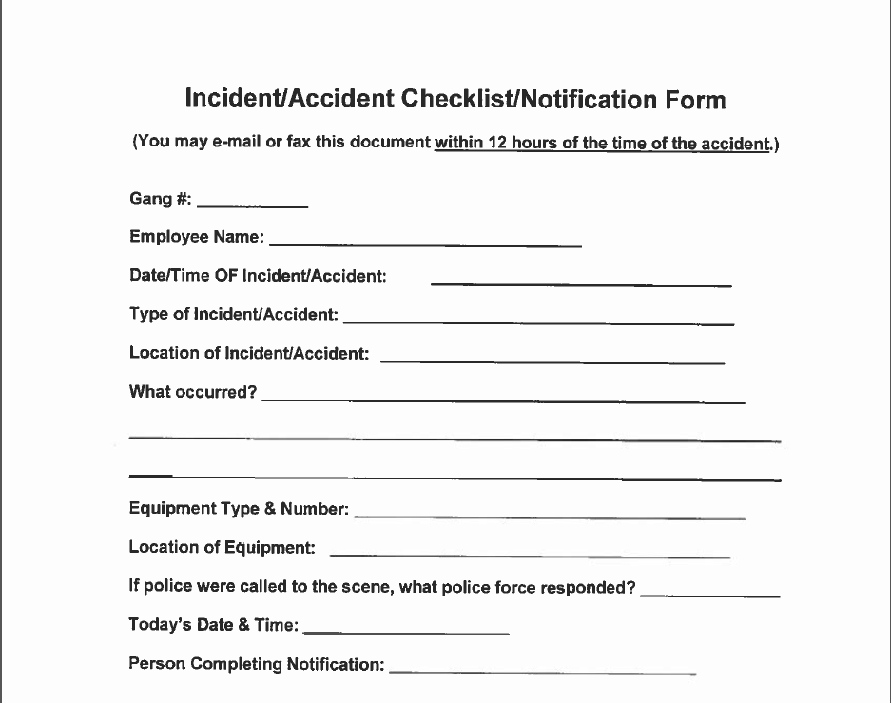
Notification form
Notes:
Needs to be done as soon as possible. Prefer to have from emailed or fax. Can just email the information into us.

Slide 18
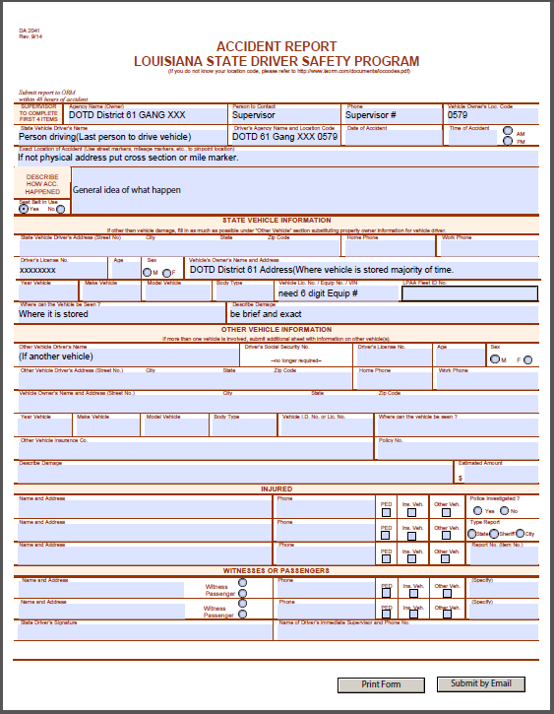
DA 2041 (Accident Report)
Used For motor vehicle accidents
Written clearly with either blue or black ink
  No red pens
  No pencil
Typed
See example (it uses district 61 for its location) Each location has a different location code. If unsure of yours contact safety.
Notes:
-Used in every motor vehicle, equipment, and off road equipment
-only blue and black ink
-If it can be typed. It is preferred. Give handwritten copy to Clerks to type and send.

Slide 19
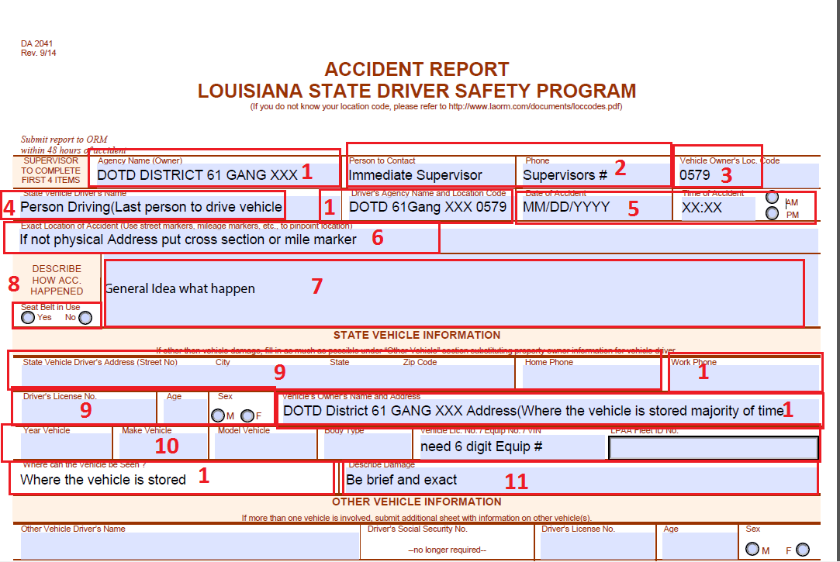
DA 2041
Notes:
Always going to be your section. Put the section that the operator and vehicle belong to. If vehicle belongs to different gang state in vehicle information. Put the number for the gang(most operators will not have a work number)
The immediate supervisor of operator
Use your sections Location code
Person operating vehicle or the last operator
2 digit month and day. 4 digit year. 12 hour time
If there is no physical address describe the area by land mark
General idea what happen. Be brief and exact. You are not trying to defend yourself. Just facts
Should always be marked yes unless you are not wearing one
Operator/last operator information
Must have 6 digit equipment number. Everyone should be able to know this information on there vehicle. If you do not know contact supervisor or safety to help
Be brief and exact.
Other portion self explanatory

Slide 20
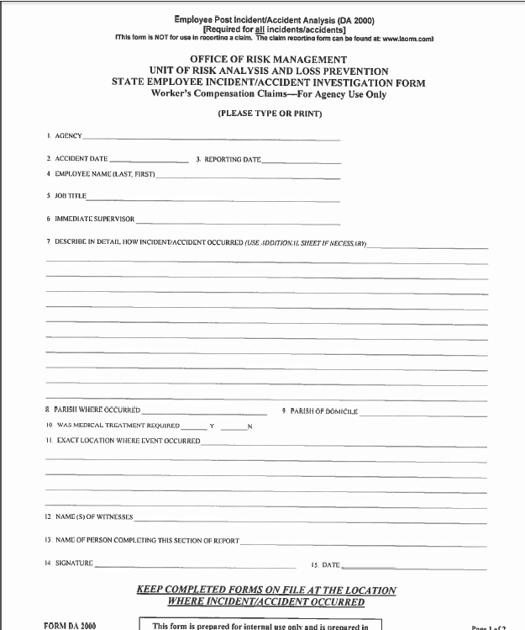
DA 2000
Notes:
Filled out by operator or person injured
Filled no matter what for Personal injury
Just facts do not defend yourself.

Slide 21
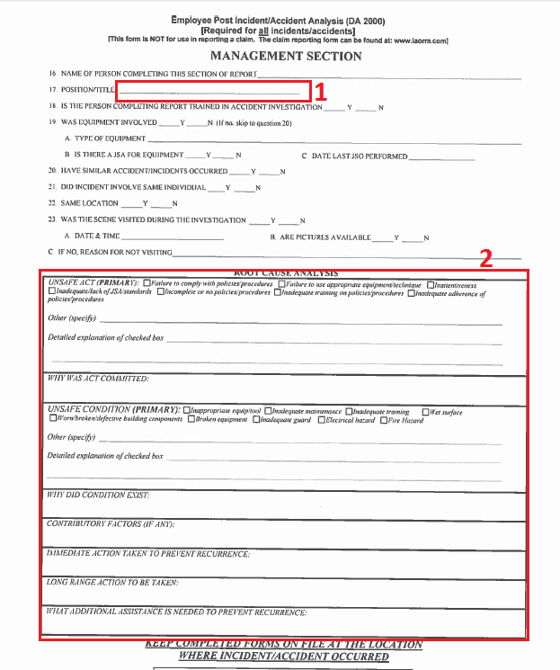
DA 2000 cont
Post Analysis
Notes:
Investigation form
Foreman or above are the only ones that can fill out form
Immediate supervisor
Went over in gathering information
N/A will not be taken
Nature of work (Unsafe act)
Only stating facts
Be detailed on information
Item 18 should be yes if you have reviewed this power point or received training on accident investigation.

Slide 22
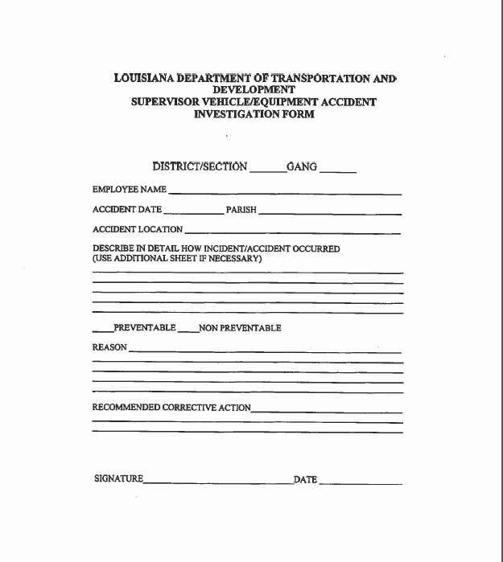
Supervisors Vehicle Investigation form
Notes:
Only immediate supervisor. Not placing blame. Only stating facts. If facts make in preventable than list. Safety Committee are the ones that ultimately place preventable or non preventable tag

Slide 23
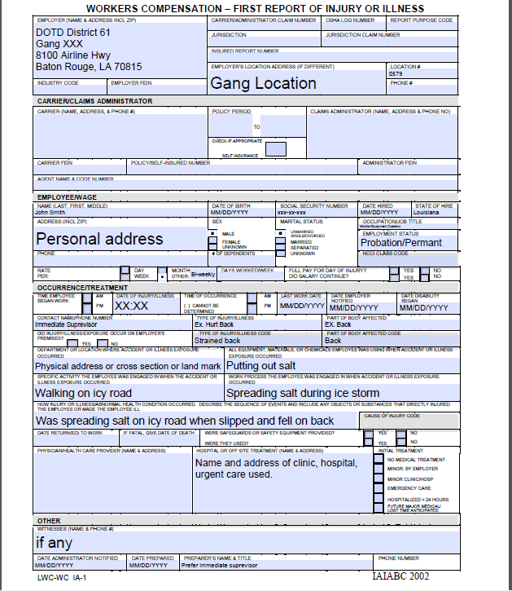
Workers Compensation (Personal injury)
Notes:
Employers name and address
District 61 is used as an example
Location is your sections number
Phone number can be easy contact number for employee
Example of injured employee
Dates always 2 digit month, 2 digit day, and 4 digit year
Personal address
Martial status no required
Occupation title spell out (no MEO 1)
Employee should either be permanent or probation
Personal Phone number
Rate of pay always bi-weekly
Days work(4-10s, 8s, or 4-9and 4
Immediate supervisor
Not trying to tell story. Just list facts. Be brief.

Slide 24
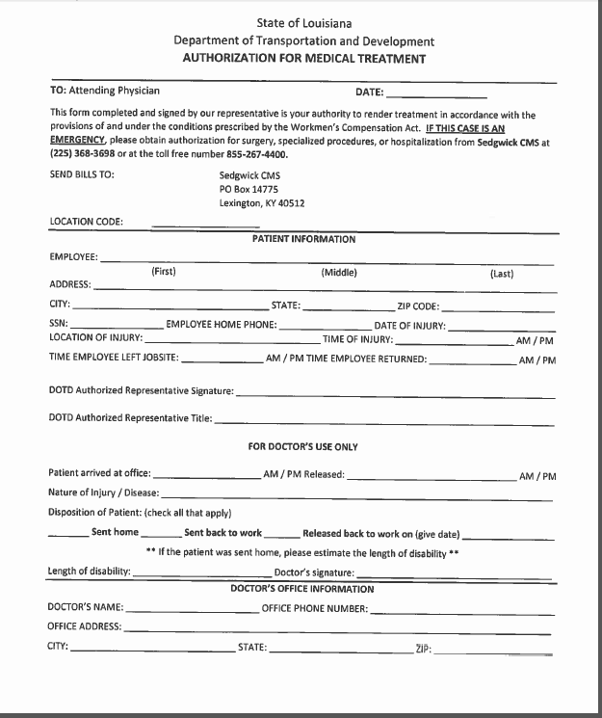
Authorization for Medical
Notes:
Can only be signed by supervisor or appointing authority.

Slide 25
Drug Testing
When is drug testing required
  CDL
  Fatality

